Slide 1
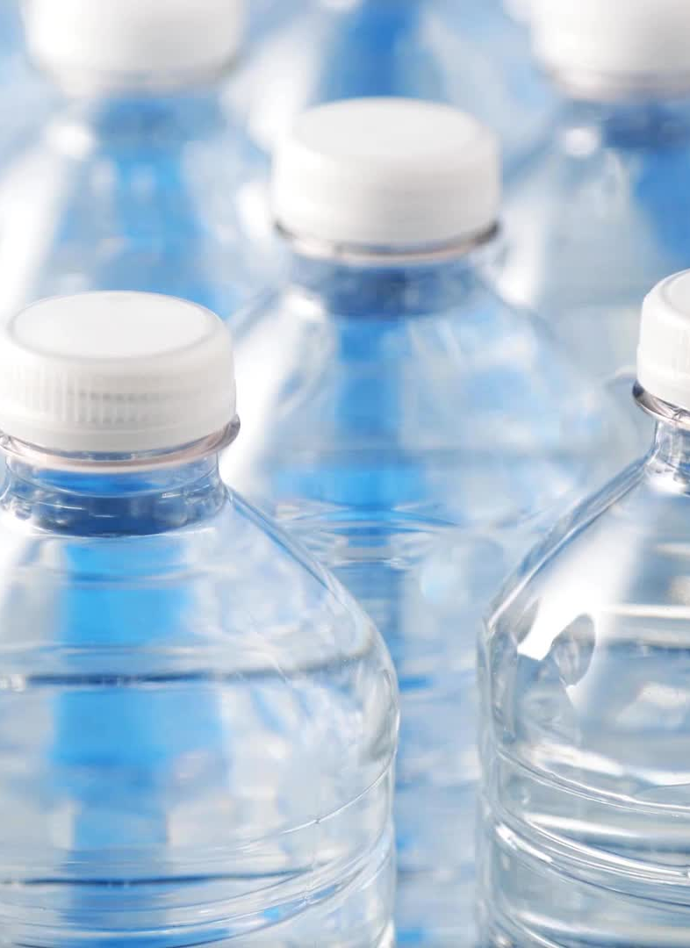
Drinking Water Potability Prediction
Group Members:
Navneet Kaur (0792027)
Harmanpreet Kaur Sumal(0795660)
Manpreet Kaur (0794006)
Navdeep Kaur (0795879)

Slide 2
Content Introduction Problem statement Project objective Description about Dataset and Features EDA Visualization Further process

Slide 3
Introduction
As we all know, water is essential for our health since, while individuals can go three days without food, they cannot survive without water . We use water for a variety of things, including cooking, bathing, farming, and washing clothing, but not all water is suitable for human consumption.
According to the World Health Organization, 97 million Indians, second only to Chinese people, do not have access to adequate healthcare.

Slide 4
Problem Statement
The problem statement revolves around predicting the potability of drinking water sources in India to address the following issues:
Waterborne Diseases
Public health impact
Lack of Monitoring System
Resource optimization
Policy and Decision Making

Slide 5
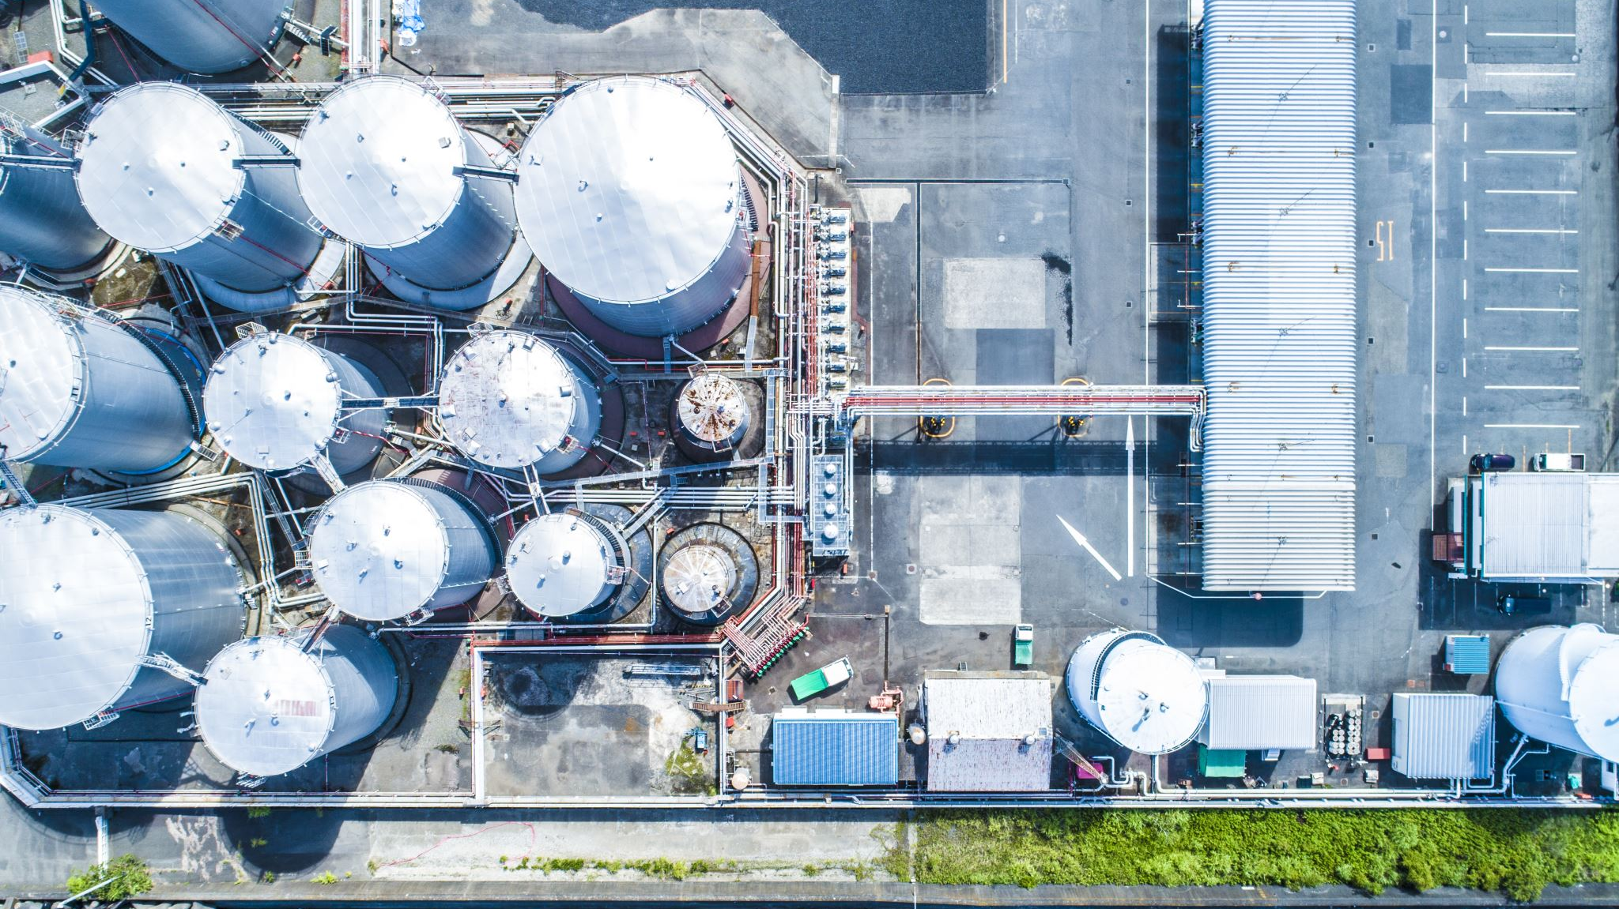
Why water is not safe to drink in India?
Water contamination or water pollution in India is primarily caused by :-
Industrial waste Improper agricultural practices Reduction in water quantity in plain rivers Oil leaks from ships Acid rain Global warming Eutrophication Inadequate industrial wastewater treatment

Slide 6
Why is this problem important to solve ?
Public health protection
Prevention of waterborne outbreaks
Efficient allocation of resources
Sustainable development

Slide 7
Project Objective
The main objective of the project is predicting the quality of water.
Project also aims a reliable, affordable, consumer oriented and sustainable potable water supply and sanitation services.
The system will help reduce people’s consumption of poor-quality water and consequently curtail horrific diseases such as typhoid and diarrhea.
To understand what constitutes safe, potable water and distinguish between potable and non-potable water by applying machine learning techniques.
In this case, our application can improve water pollution in different water bodies.

Slide 8
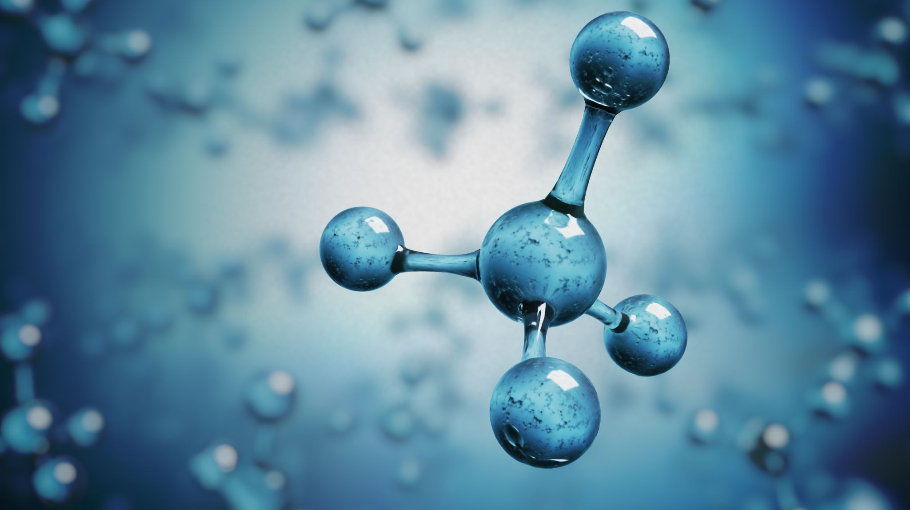
About Data and Feature Description
The Data has selected from Kaggle and certain location in India. There are 1991 rows and 12 columns and it has contains 3276 different Water bodies.
pH: pH is measured on a scale from 0 to 14. A pH value below 7 indicates acidity, a value of 7 is neutral, and a value above 7 indicates alkalinity.
Total coliform: Total coliform is a group of bacteria that are commonly found in the environment, including soil, vegetation, and animal feces.
Temperature: It can influence the solubility of chemicals, the growth of microorganisms, and the overall water quality.
Dissolved oxygen: Dissolved oxygen refers to the amount of oxygen gas dissolved in water. It is essential for aquatic life and is an indicator of water quality. Adequate dissolved oxygen levels are necessary to support healthy ecosystems.
BOD (Biochemical Oxygen Demand): High BOD levels can deplete dissolved oxygen, leading to harmful effects on aquatic organisms.
Conductivity:. It provides an indication of the concentration of dissolved salts, minerals, and other substances in the water.

Slide 9
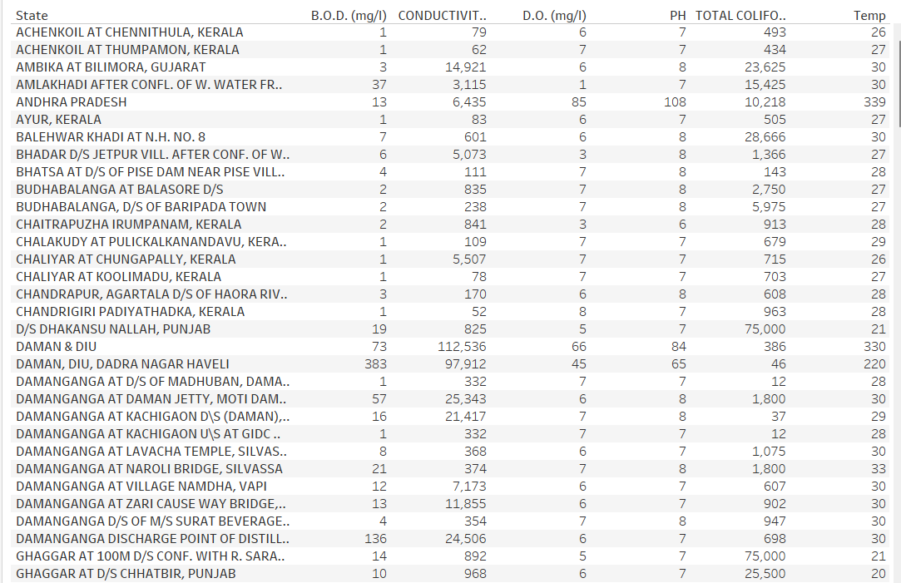
EDA

Slide 10
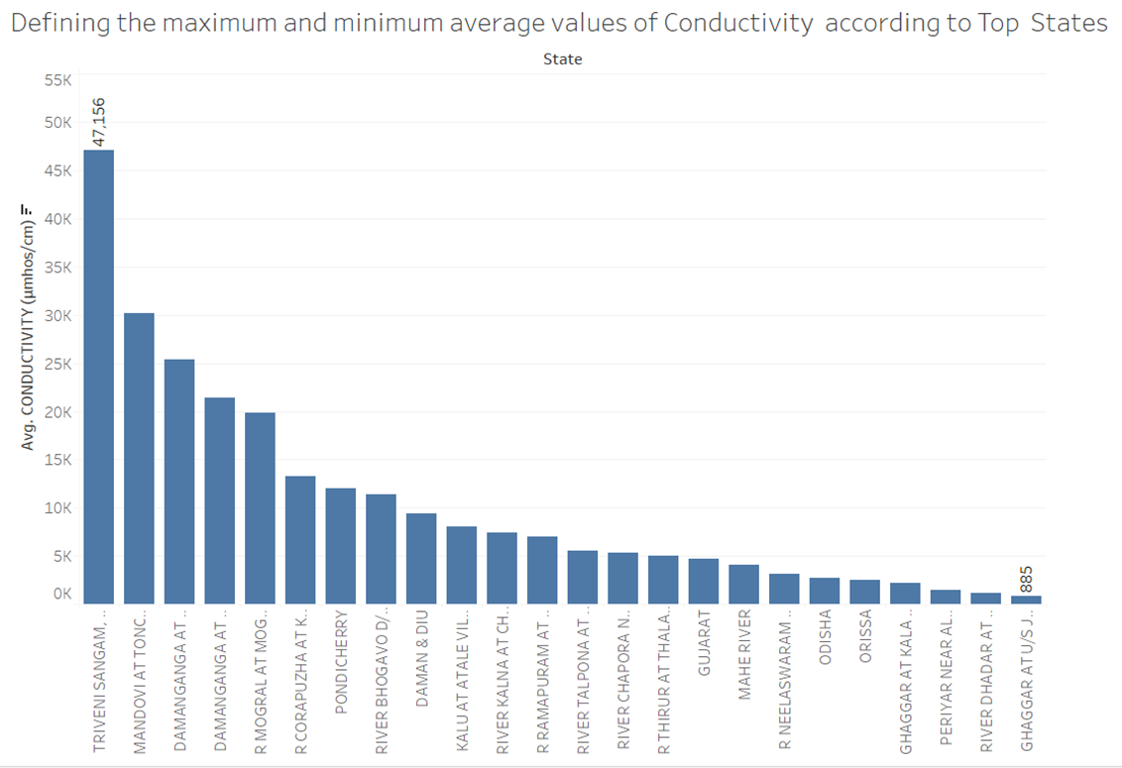
Average Values Of Conductivity According to Top States

Slide 11
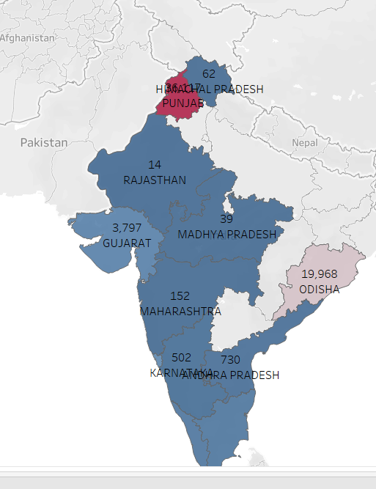
Average of Total Coliform According to States

Slide 12
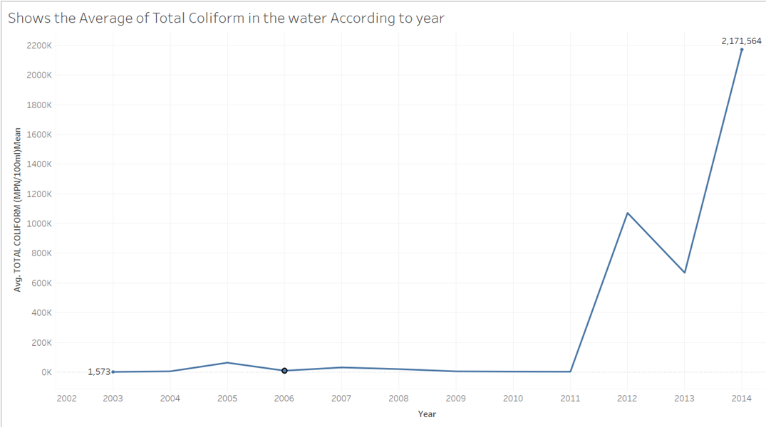
Average Value of Total Coliform With Respect to Years

Slide 13
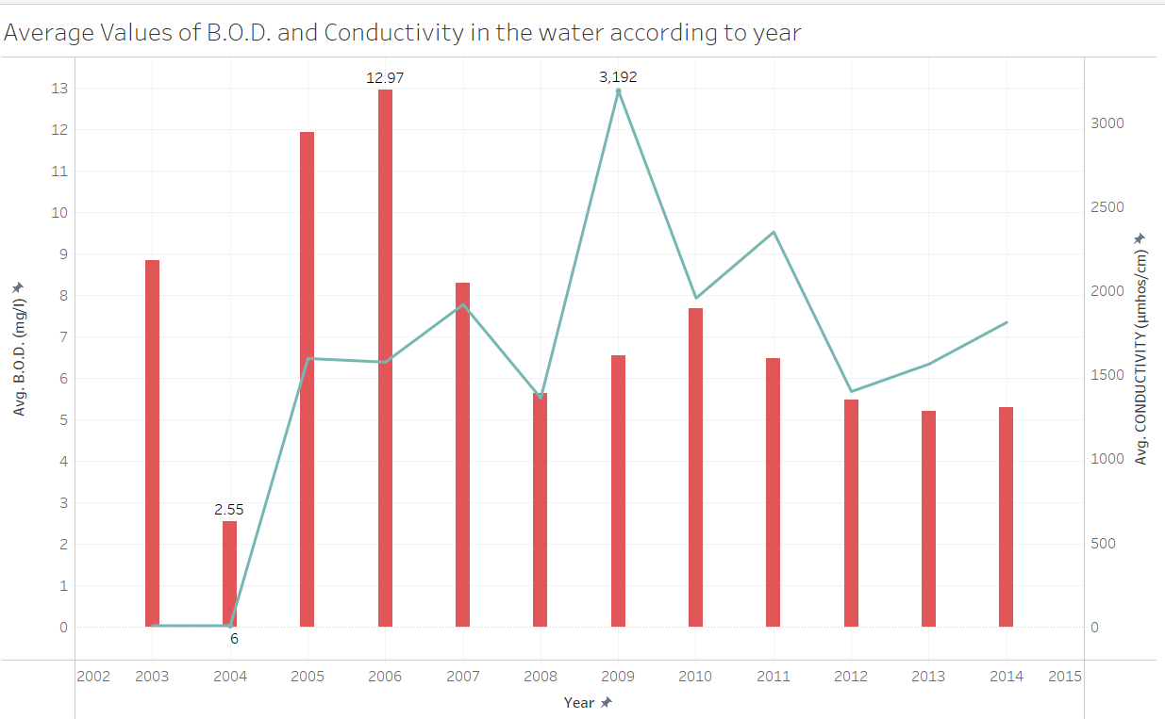
Average Values of B.O.D. and Conductivity

Slide 14
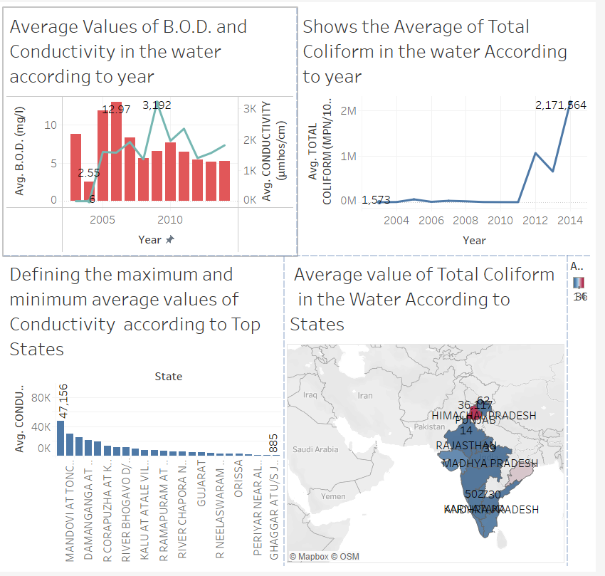
Visualization

Slide 15
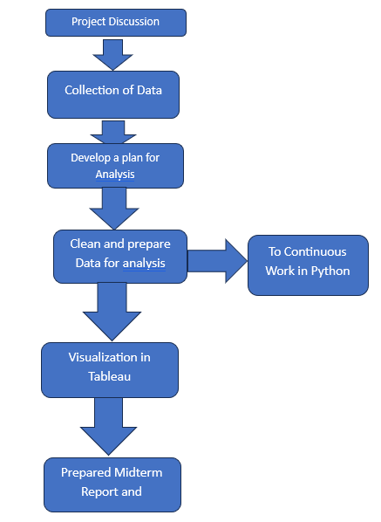
Project Process Complete Until today

Slide 16
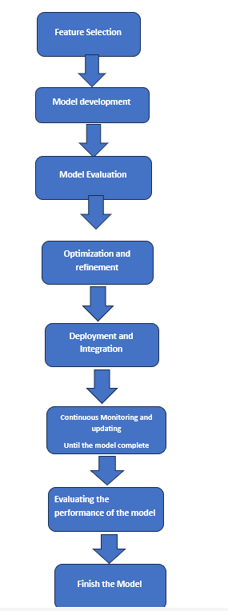
Further Process to Finish the Project

Slide 17
Thank you

